Slide 1

RAGE QUIT
The Fumbling Five:
Yong Lu (Product Owner)
Jeremy Euchi (Developer)
Victor Chung (Developer)
Jared Tran (Developer)
Brooke Clement (Developer)

Slide 2
Purpose
The team wanted to learn Unity.
The game Rage Quit takes inspiration from real life rage rooms. Users can take out their anger, stress, and frustration in a safe environment and have fun doing so!

Slide 3
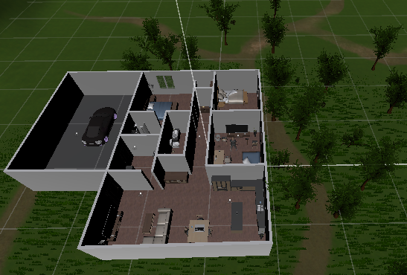
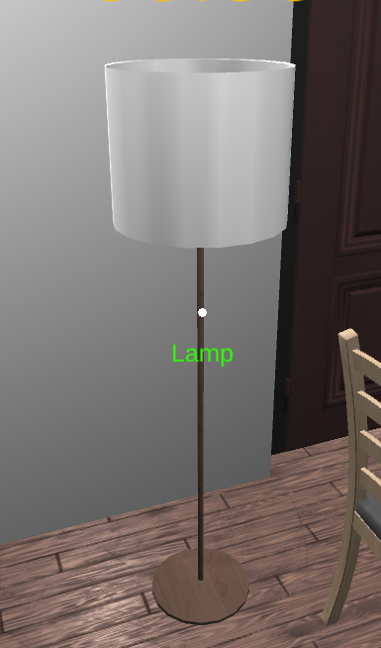
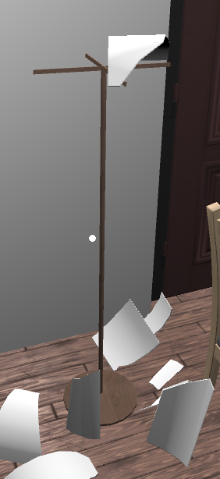
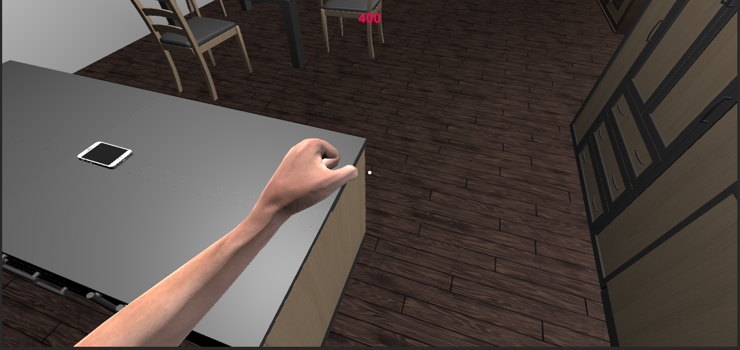
Goals
3D Style Game with Realistic House
Interactable and Breakable objects
First Person Experience

Slide 4
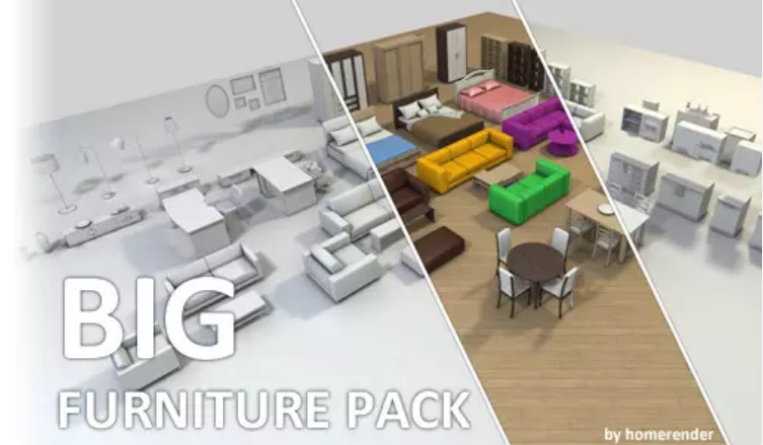


Technologies
Mainly used Unity, with scripts written in C#
Assets used from the Unity Asset store
Blender
Github

Slide 5
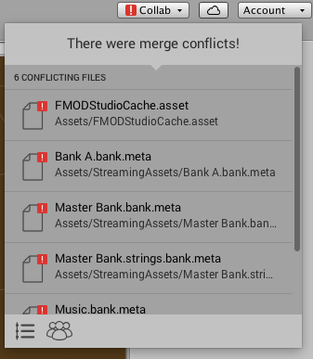
Challenges
Merging code in Unity
Unfamiliarity with working in Unity
Learning and creating animations with Blender
Adjusting meetings to be online instead of in person
Optimization Problems
Bugs emerging out of nowhere. More bugs after fixing a bug.

Slide 6

Live Demo

Slide 7
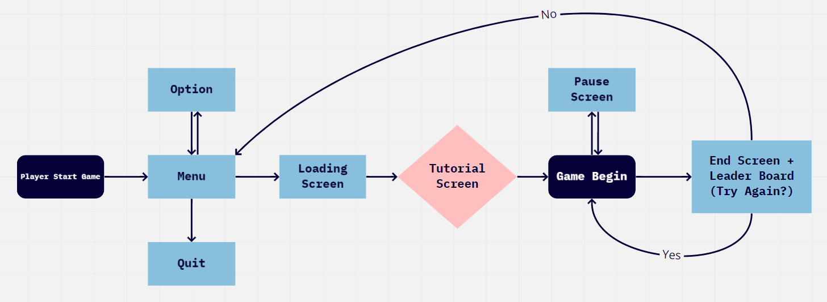
System Overview

Slide 8


Project Management Techniques
Discord for Scrum meetings
Unity Collaboration for source control
Trello for Scrum board

Slide 9
Our Experience
Enjoyed
Learning new technologies
Working together as a team
Planning the design of the game.
Testing the game
Didn’t Enjoy
Remote Learning
Working on the project through discord instead of meeting in person.
Merge conflicts.
Unity bugs and problems.

Slide 10
Lessons Learned
RayCast in Unity
Creating broken versions of existing models
Multiple meetings per week essential for making good progress
Important that team members are aware of tasks completed and tasks to be done
You can never fix all the bugs.

